Slide 1





AMP Finances, LLC
Loan Default Risk Prediction Using Machine Learning
Presented by: Yusuf Alam, Trayshawn Mitchell, Steven Pierce
Start Slide

Slide 2


AMP Finances, LLC
Contact Us
Predicting Loan Defaults
Executive Summary
AMP Finances, LLC was tasked with predicting loan defaults using machine learning to help Capital One institutions reduce risk and improve lending decisions.
Business Impact:
Enhances risk assessment models.
Reduces financial losses due to defaults.
Improves responsible lending practices.
Approach:
Data cleaning & preprocessing.
Exploratory data analysis (EDA).
Model selection & evaluation.
Insights & future improvements.

Slide 3




AMP Finances, LLC
Contact Us
Dataset Overview & Preprocessing
Key Features:
Borrower demographics.
Financial indicators (income, debt-to-income ratio, credit score, loan amount).
Loan history & default status.
Preprocessing Steps:
Handled missing values using mean imputation & categorical encoding.
Standardized numerical features.
Feature selection based on correlation with default risk.

Slide 4
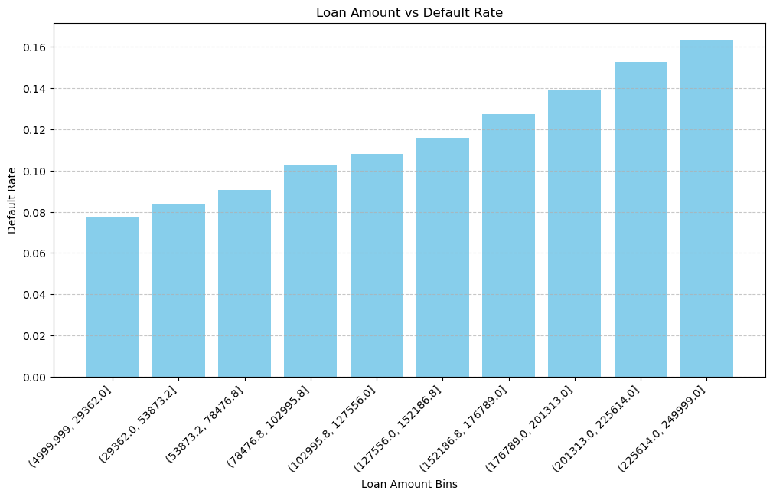
AMP Finances, LLC
Home
About
Contact Us
Exploratory Data Analysis (EDA)
Key Insights from Data Analysis:
Higher loan amounts correlate with increased default rates.
Low credit scores significantly increase default risk.
High debt-to-income ratios are strong default predictors.

Slide 5
AMP Finances, LLC
Home
About
Contact Us
Key Features in Dataset:
Borrower Information
Age – The borrower's age.
Income – Annual income in dollars.
Months Employed – How long the borrower has been employed.
Credit Score – A numerical score assessing borrower creditworthiness.
NumCreditLines – Number of active credit lines.
Loan Details
Loan Amount – The total loan amount requested.
Interest Rate – The percentage interest on the loan.
Loan Term – Loan duration in months (e.g., 12, 24, 36, 60 months).
DTI Ratio (Debt-to-Income Ratio) – Measures how much of the borrower's income goes toward paying debts.
Other Factors
Education – Highest education level attained.
Employment Type – Full-time, part-time, self-employed, or unemployed.
Marital Status – Whether the borrower is single, married, or divorced.
Has Mortgage – Whether the borrower has an existing mortgage.
Loan Purpose – The stated reason for taking the loan (e.g., Auto, Business, Other).
Has Co-Signer – Indicates if a co-signer is involved.
Summary Insights
Average Age: 43 years
Average Income: $82,499
Average Loan Amount: $127,578
Average Credit Score: 574
Average Interest Rate: 13.5%

Slide 6
AMP Finances, LLC
Home
About
Contact Us
Machine Learning Approach
Models Evaluated:
Model Training Strategy:
Logistic Regression (Baseline Model)
Random Forest Classifier (Best Performing Model)
Decision Tree Classifier
Data Preprocessing
Split dataset into 80% training, 20% testing
Measured performance using accuracy, precision & recall, and ROC AUC scores

Slide 7
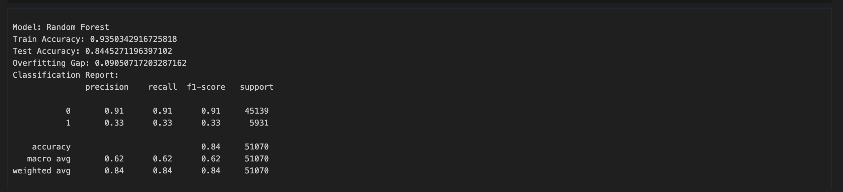
AMP Finances, LLC
Home
About
Contact Us
Machine Learning Model Output

Slide 8
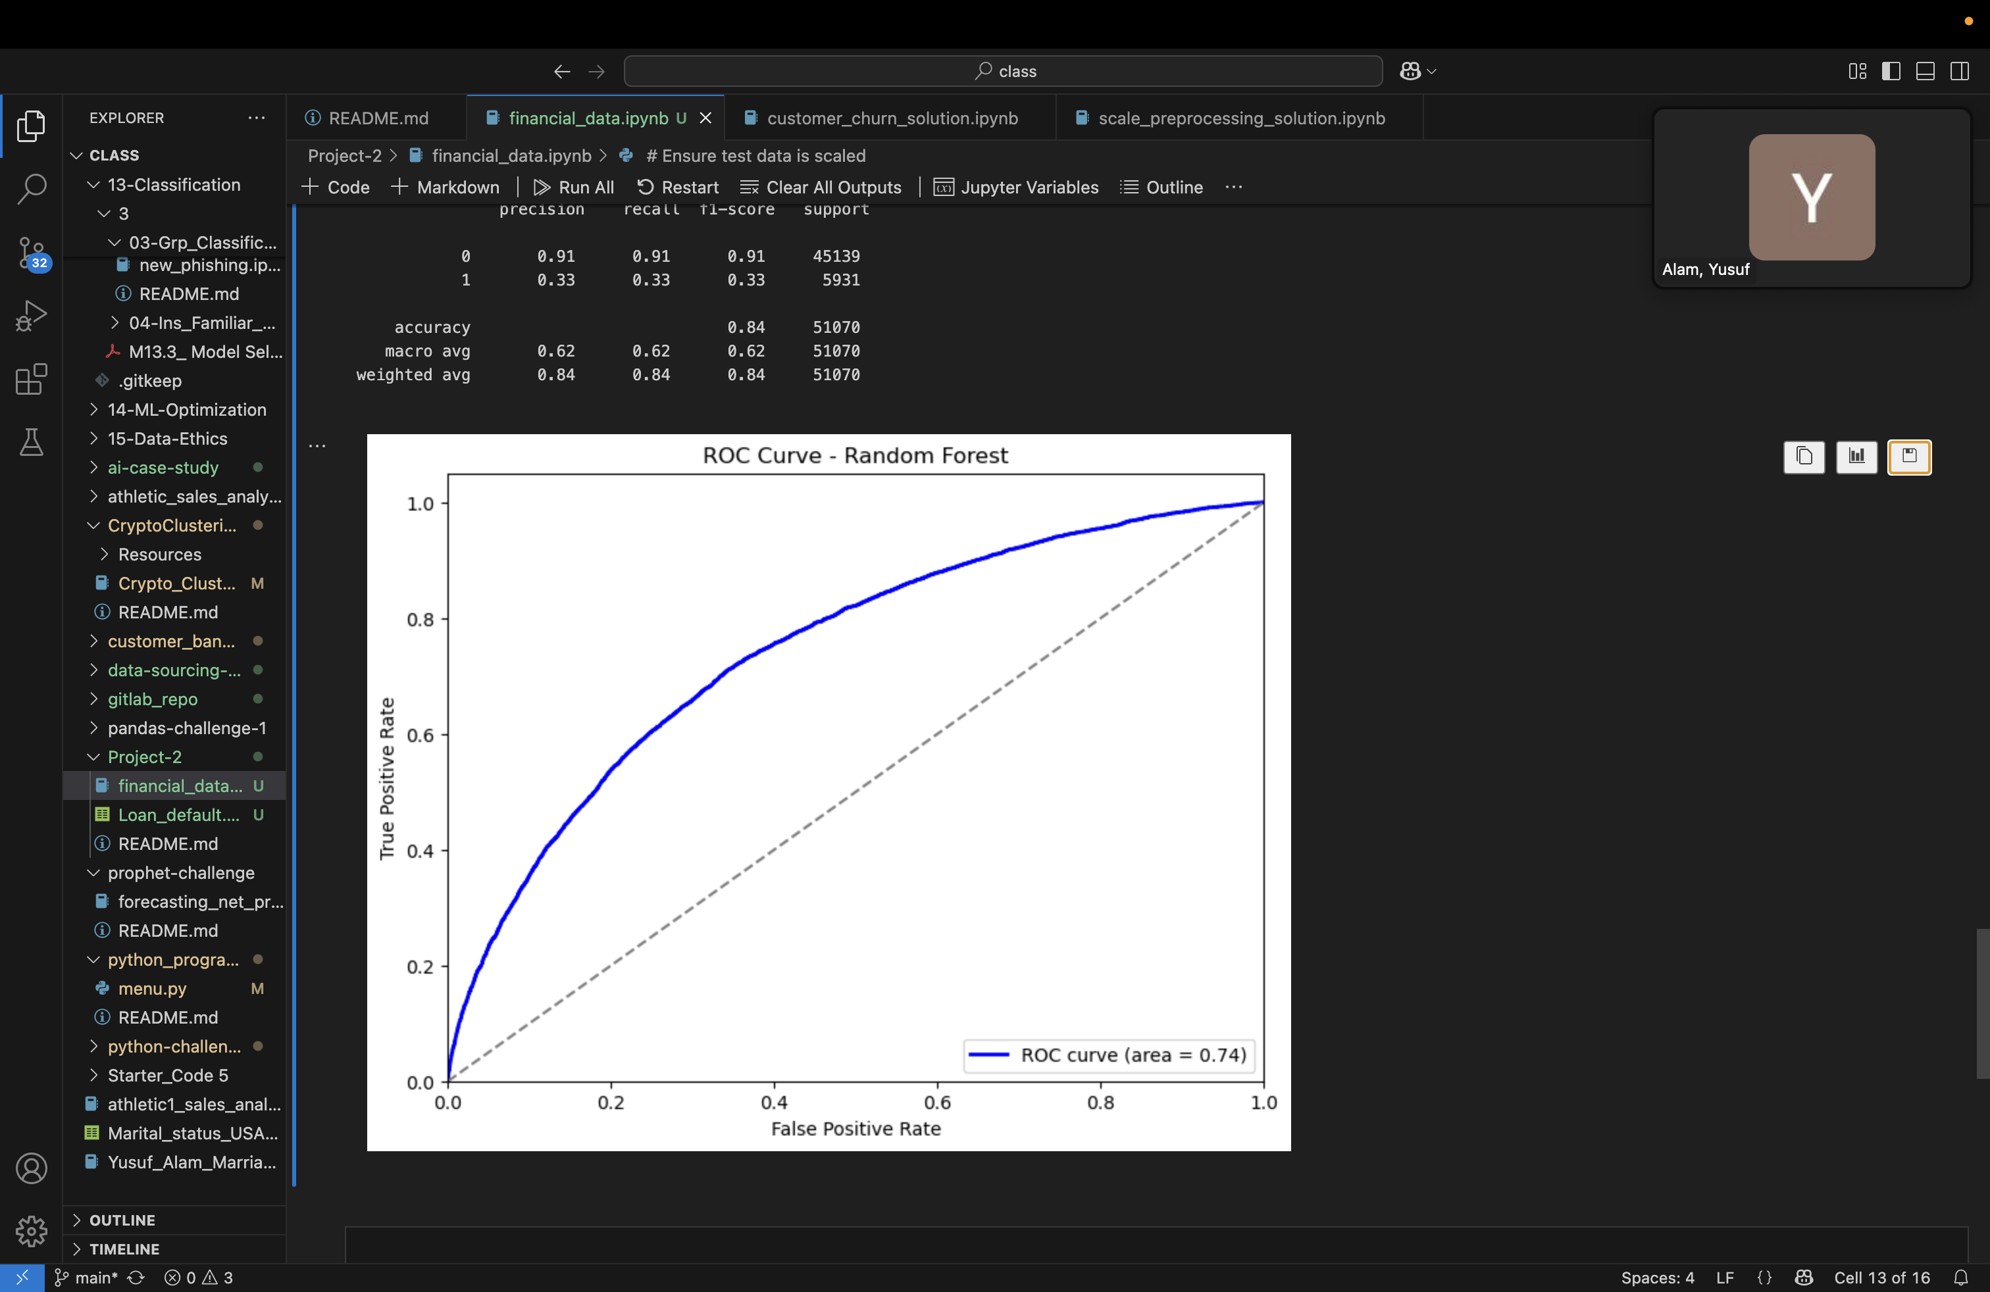
AMP Finances, LLC
Home
About
Contact Us
Model Performance Comparison
Evaluation Metrics:
Accuracy: Measures correct predictions.
Precision & Recall: Trade-off between false positives and false negatives.
AUC-ROC Score: Measures classification performance.
Results:
Logistic Regression: 75% Accuracy, ROC = 0.71
Random Forest: 84% Accuracy, ROC = 0.74
Decision Trees: 68% Accuracy, ROC = 0.63
Place Holder, I suggest we do a ROC Curve Comparison

Slide 9



AMP Finances, LLC
Home
About
Contact Us
Business & Financial Implications
How This Model Helps Capital One Institutions:
More accurate risk assessment → reduced loan default rates.
Allows for better interest rate pricing based on individual risk profiles.
Enhances regulatory compliance & financial stability.
Potential Implementation:
Deploy as API for real-time loan risk scoring.
Integrate into underwriting systems.
Our Model
Reduces financial losses due to defaults.

Slide 10
AMP Finances, LLC
Contact Us
Challenges & Future Enhancements
Challenges Faced:
Future Research & Development:
Imbalanced dataset requiring SMOTE.
Limited features on borrower behavior.
Incorporate alternative data sources (e.g., spending behavior, employment history).
Experiment with deep learning models (Neural Networks, LSTMs).
Build a real-time loan risk prediction dashboard.

Slide 11



AMP Finances, LLC
Home
About
Contact Us
Conclusion
Key Takeaways:
Random Forest Classifier provides the best predictive performance.
High loan amounts, low credit scores, and high debt-to-income ratios are key risk factors.
Machine learning enhances financial risk management.
Next Steps:
Optimize the model further.
API Deployment – Converting the model into an API so lenders can send loan applications for real-time risk scoring.
Integration with Banking Systems – Embedding the model into underwriting software to automate loan approvals.
Monitoring & Updating – Continuously tracking model performance and retraining with new data to maintain accuracy.

Slide 12


AMP Finances, LLC
Contact Us
THANK YOU
Back To Home

